Slide 1
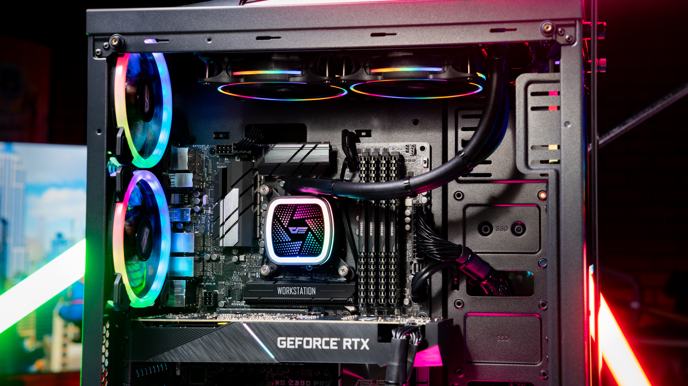
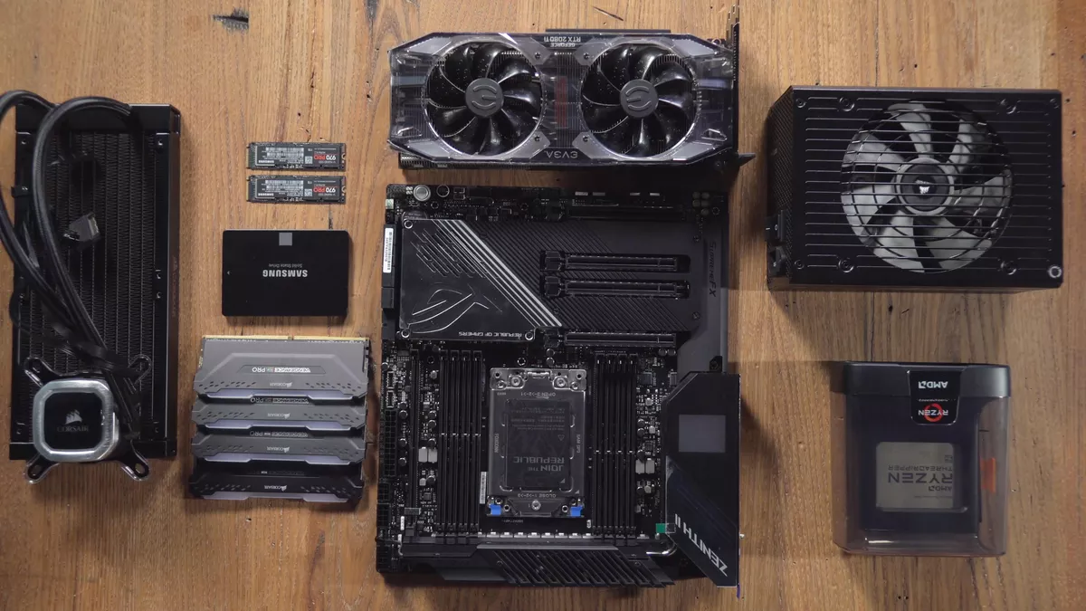
Custom PC Planner
Gustavo Cisneros
CECS 491A Spring 2020

Slide 2
The Problem to Solve
Gathering & building PC parts rather than buying a prebuilt PC can be intimidating for people completely unfamiliar with computers
Computers have different working parts that all come together to form a complete functioning system
While tech-literate people know what/how individual components function and what to buy, there is a larger number of people that have absolutely no clue what each part of a computer does, let alone how to put all the pieces together
If a person new to PC building wants to build a new system, they might want to set a particular budget based on their needs/limitations
Some people want to make a computer simply for work-related purposes, others want to make one for gaming, others want a 2-in-1 combo, etc.

Slide 3
The Solution
A mobile application directed towards people completely new to PC building (no prior knowledge/experience whatsoever)
would provide methods of searching for different parts for each component category and add it to the list of parts for a complete build
The application would also be informative, explaining to newcomers in layman’s terms what each part does and how each part contributes to your needs
Ex: want to game? Look for a substantial GPU. need lots of browser tabs open at once? More RAM is preferrable, etc
Would keep track of the cost of all parts & manage a user’s budget, letting users know if they went over their budget and adjust their build accordingly
Parts might be recommended within specific price ranges/tiers to help stay within a budget
Users can create accounts where they can log in, make seperate profiles for potential PC builds, and save them for future reference.

Slide 4

Uniqueness of the Idea
A PC building website already exists and is used by PC building enthusiasts: PCPartPicker https://pcpartpicker.com/
The website uses some kind of web scraper/API to pull PC parts from major retailers and get their prices, info, calculates total price
Main difference: PCPartPicker is not exactly beginner friendly:
it does not explain which parts you should choose
Does not explain what each part does
does not recommend parts based on budget
no mobile version available (their mobile site is the same as their desktop site which is inadequate for mobile use)
Unique features:
Mobile version with an intuitive and simple to use UI
Informative pages to help users understand what each component does
Recommend parts based on budget or personal needs
Search for specific parts and compare prices from different retailers

Slide 5



Practicality
Real needs:
PC building is a growing hobby, especially during COVID-19
More people are looking into building a computer, but do not have an application to help them in a streamlined and intuitive fashion
PCPartPicker can be very confusing for some newcomers (speaking from personal experience helping others build computers) because it only gives you a list of parts but not what they do
It doesn't recommend parts based on a user’s needs
Job Opportunity Benefits
Learning how to integrate different API’s into a big project
Learning how to build webapps using JavaScript and development frameworks (React Native, AngularJS, etc.)
Building intuitive and well-designed UI centered around mobile use
Learning how to use a database to store and retrieve PC component info (SQL)
JS and SQL are two of the most in-demand languages employers seek
Current Trends
JavaScript is highly popular and in high demand, and is projected to remain in high demand for years to come

Slide 6


Project Type
The project would take form in some kind of mobile application
Project in web-app form would be preferable, since it would be available to a much wider user base and be easier for people to access without much or any limitations
Mobile app would likely use languages that are best for mobile web-apps JavaScript, React Native, HTML, etc.

Slide 7
Technical Hurdles
Largest technical challenge is searching for current PC parts available for purchase on major retail websites (Amazon, Newegg, Best Buy, etc.)
Computer component information must be collected efficiently and accurately
Collected PC part information must be stored in some kind of structured database for effective storing and retrieving of component information
Making the UI streamlined and simple enough for anyone to use
Finding the proper languages and frameworks needed to program the app to work on multiple platforms

Slide 8
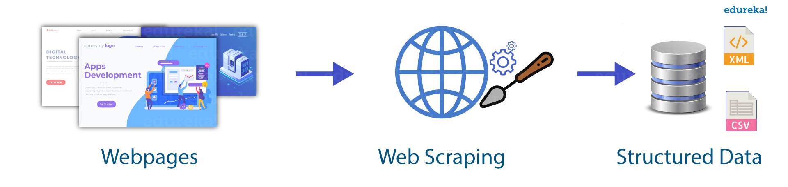

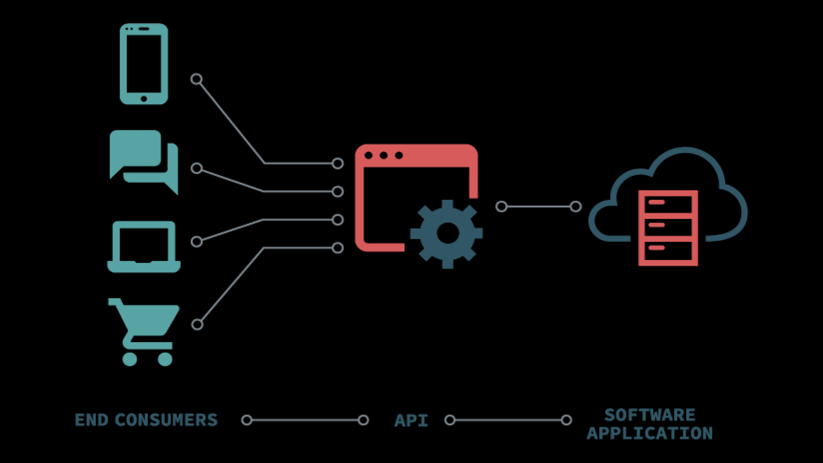
Third Party Supports
The application would be developed using JavaScript and some libraries/frameworks such as React Native, Flutter, etc.
The application would use some kind of backend database server to keep an up-to-date list of components currently available for sale
The application would need to take advantage of some APIs provided by major retailers (AWS, Axesso Walmart Data Service, Best Buy API)
Web scrapers might also be used in situations where a retailer does not use/provide an API

Slide 9
Useful Skills
JavaScript knowledge (both front-end and back-end)
Familiarity with JS frameworks is also needed
SQL database integration skills (MySQL, Derby, etc.)
Connecting an app to a database, designing relation schemes, writing queries
Some experience using external APIs
Mobile UI design skills (needed)
Experience using online web scrapers
Minor photoshop knowledge (for custom logos, images, designs, etc.)
Some GitHub experience (repos, commits/pulls, etc)
Open to anyone whether they have experience or not! We are here to learn and develop skills together :)

Slide 10
Time Frame
Hoping that everything can be planned and made within a 2-semester period
First Half (491A)
Planning features
Learning new technologies/languages/frameworks
Planning how the UI should look/appear
Planning how the database should be structured
Which APIs/Web scraping technologies to use
Second half (491B)
Developing the UI
Integrating APIs/frameworks into the application
Developing each feature

Slide 11
Any questions?

